Slide 1


innovative documentation creates more data and demands more traffic

Slide 2
Intrapreneurship Program - Application Form & Team – June 2017
Team/project name:
Short description: implementation of an app for the documentation of infrastructure.
    We are happy, that we found this option of cooperation.
    But we have to mention, that it was only two days ago.
    So this presentation is only quick draft.
Team lead: Manfred Baier
Team members: 4
By sending this application we agree for this pitch deck to be shared within the organization: Y/N
First name | Last name | Email | Phone | Company | Department | Country | City
Manfred | Baier | manfred.baier@a1telekom.at | +43 664 6630544 | A1 | CPM | Austria | Klagenfurt
Hugo | Fuchs | hugo.fuchs@ddki.eu | +43 664 3556843 | DDKI | CEO | Austria | Klagenfurt
Bernd | Steiner | bernd.steiner@ddki.eu | +43 660 5701757 | DDKI | CTO | Austria | Klagenfurt
Martin | Vierbauch | mvierbau@edu.aau.at | +43 650 3097996 | University | Marketing | Austria | Klagenfurt

Slide 3
PROBLEM:
Technical documentation in the field is still done offline, isolated and incomplete.
ADVANTAGE:
With job2map the documentation is online, synchronized, complete, objective.
Absolute unique: controlled localization of raw data acquisition e.g. images.
SOLUTION:
Completing traditional methods by using up to date technology.

Slide 4
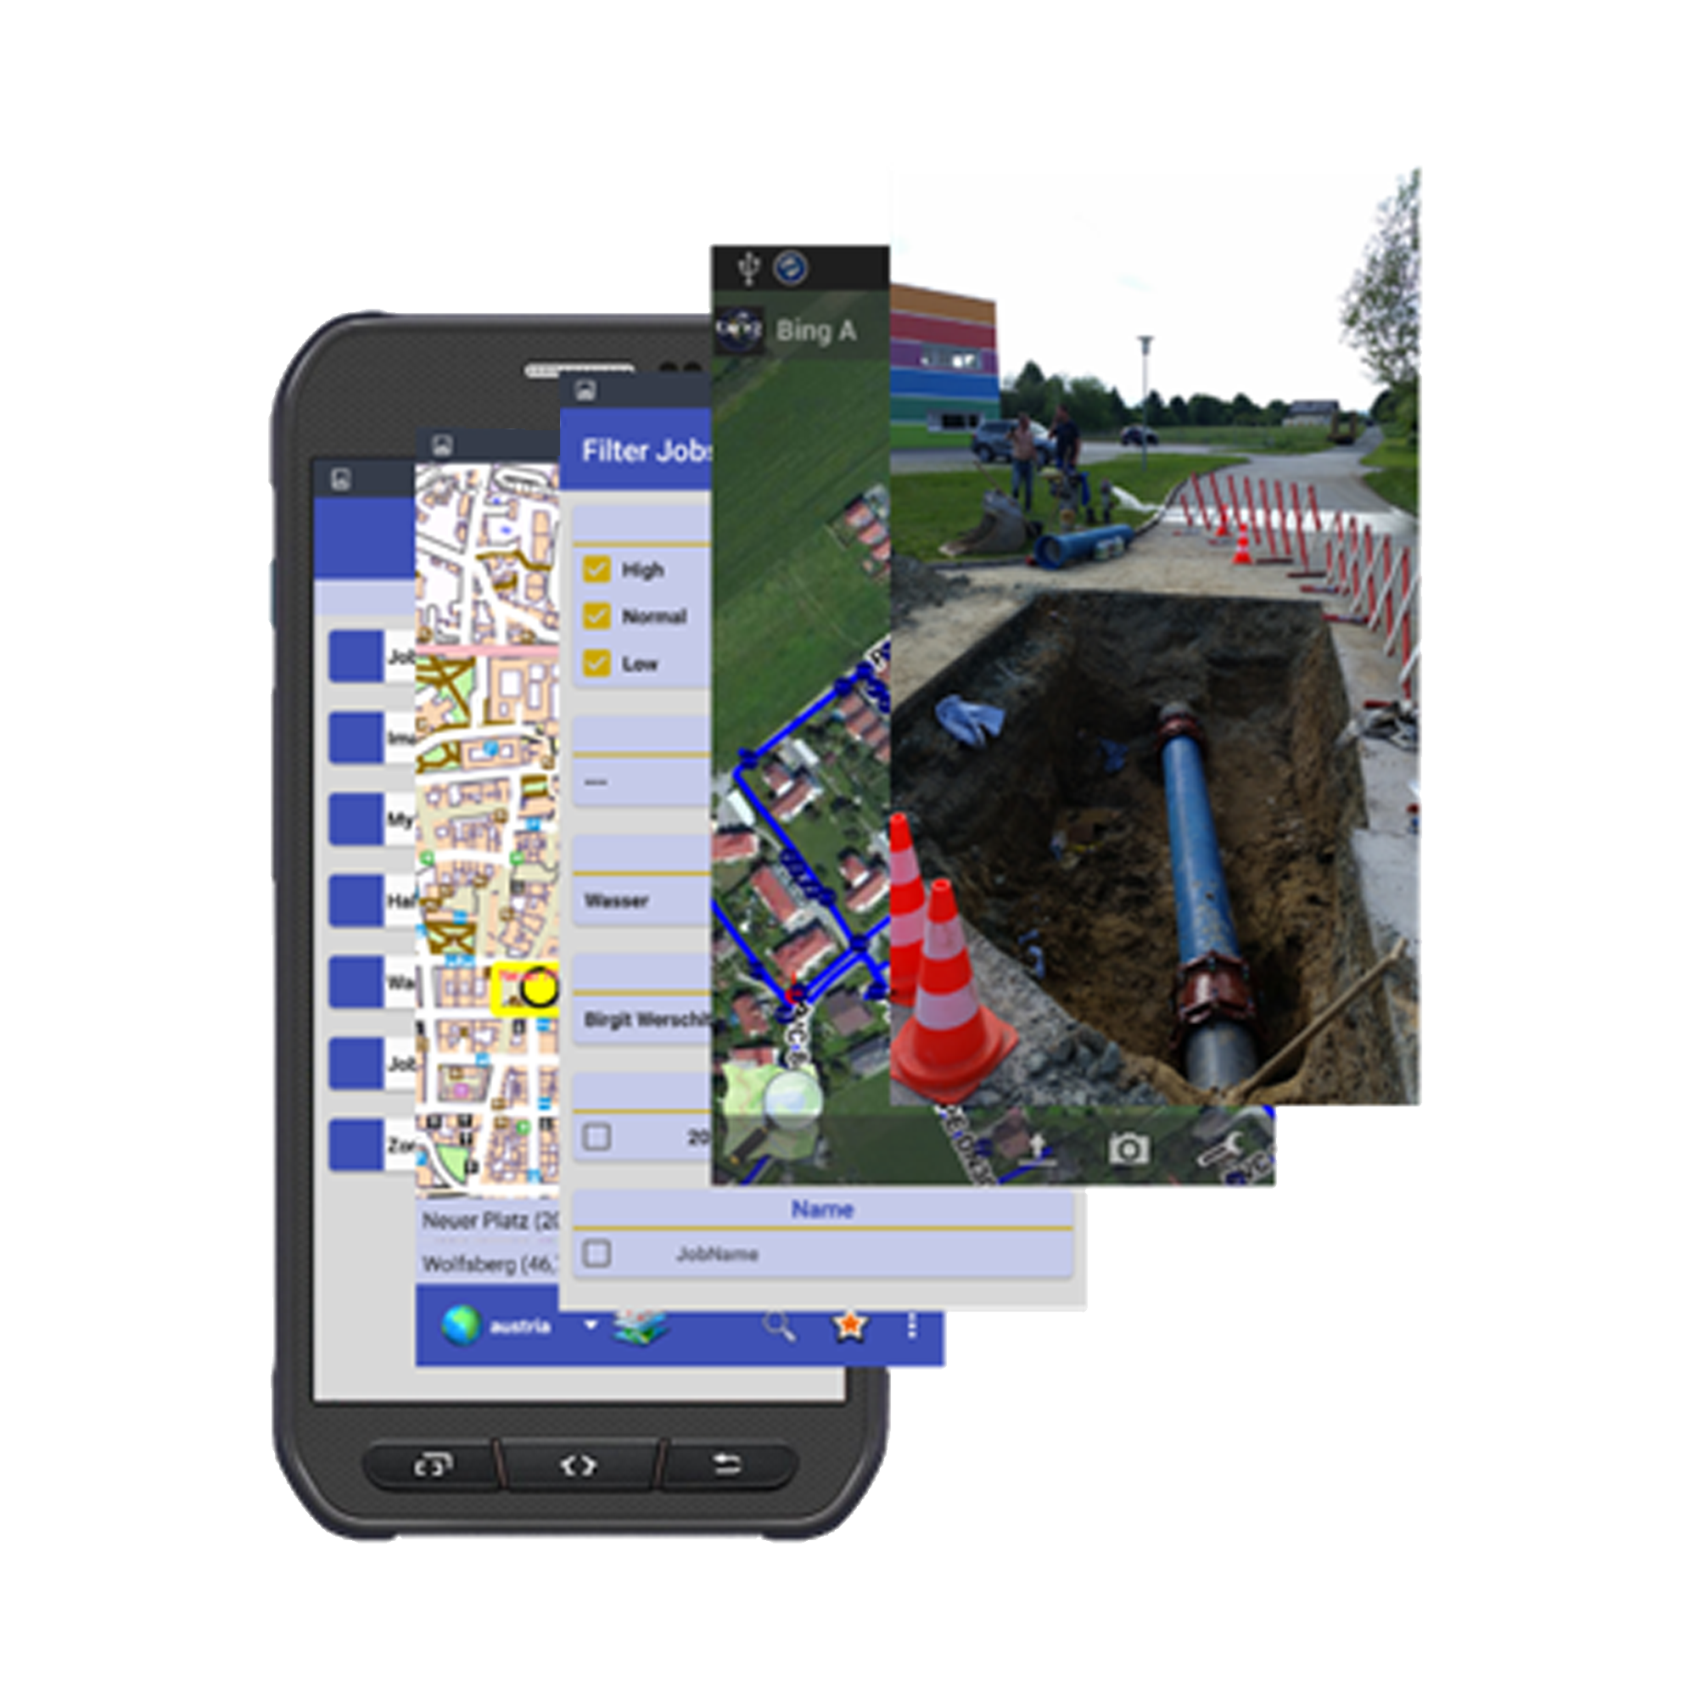
PRODUCT:
Retrieves data for a meaningful documentation.
Mobile
Dynamic
Up-to-date
View collected data quickly, safely and anywhere.
References, bundles and saves the data with minimum administrative effort.

Slide 5
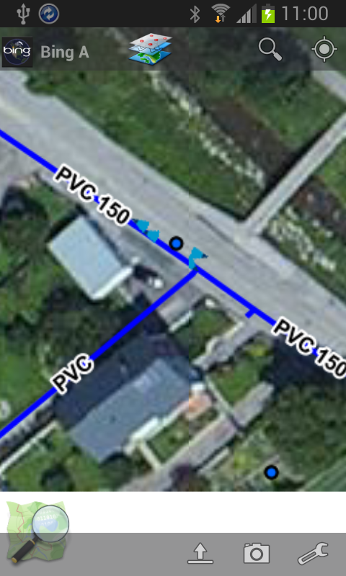
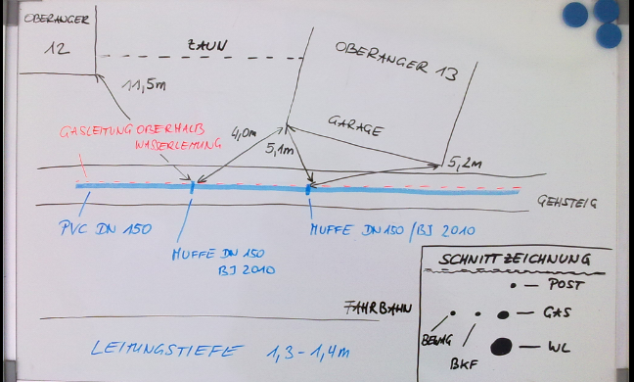
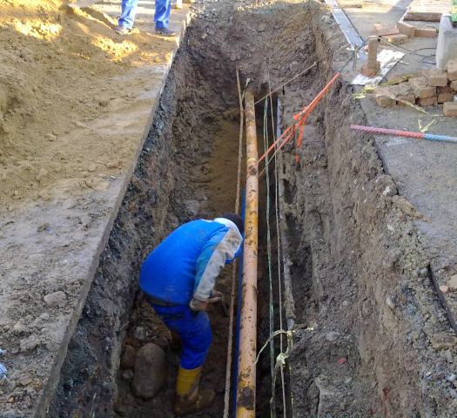
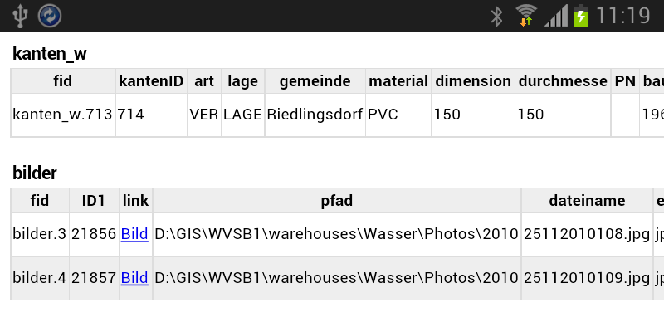
PRODUCT:

Slide 6
PRODUCT:
Without
With

Slide 7
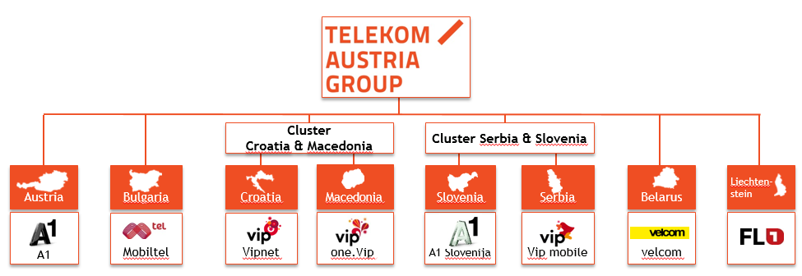
Customer & Market:
Existing Customers:
STW Wolfsberg
Gde Neumarkt
Gde St.Michael/Bgld
Firma COMIN
SETEC DOO
ViK KRALJEVO
ViK SMEDEREVO
ViK Trstenik
ViK Aleksinac
ViK Smederevska Palanka
ViK Velika Plana
ViK Knjaževac
Teststellungen:
WW Teheran
Potential Customers:
Everyone who has to administrate infrastructure over a wide spatial area!

Slide 8
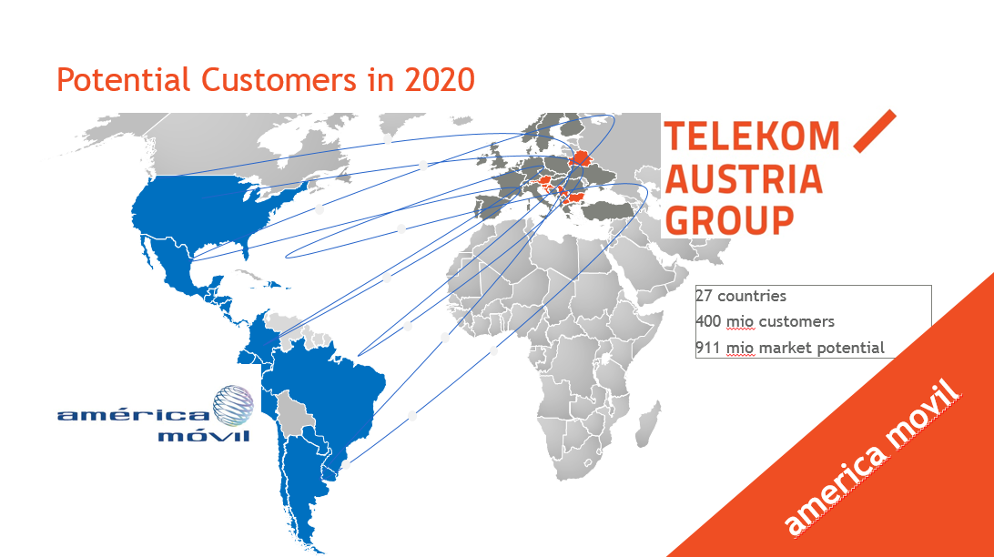

Slide 9
COMPETITION:
 | ESRI | Gis² | ICRA | GTO | job2map
Workflow administration | √ | √ |  | √ | √
Project data aquisition |  |  |  |  | √
Cost efficiency |  |  |  |  | √
Measurement |  | √ | √ |  | √
Raw-Data acquisition |  | √ |  |  | √
Raw-Data localization |  |  |  |  | √
Terminal independence | √ | √ |  | √ | √
GPS | √ |  |  |  | √
DGPS (=expensive HW) |  | √
Application | √ |  |  |  | √
Data management | √ | √ | √ | √ | √
Real-Time-GIS | √ | √ |  | √ | √

Slide 10



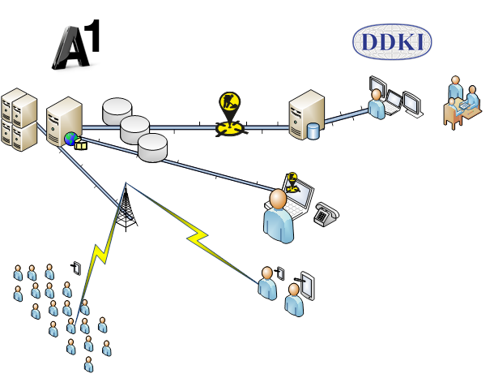
Increase sales of their own core products (mobile communications, internet access, housing and hosting).
Rollout and build up assistants for the chief developer. This can focus on research and development.
BUSINESS
MODEL
START
Pricing Service
GIS
Databases
Distribution
&
Communication
PARADIGM SHIFT
Innovative documentation creates more data and demands more traffic

Slide 11
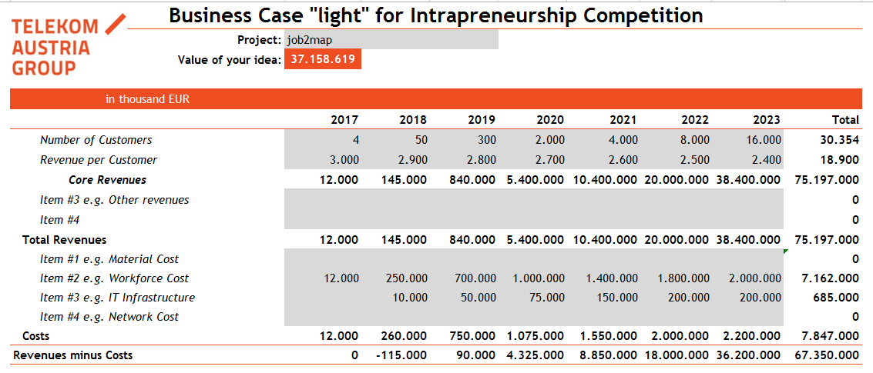
RESSOURCES:

Slide 12

job2map is an existing application, that satisfies it´s users (public utility companies in different countries).
DDKI is not able to do the Sales Job, Marketing and upscaling.
TAG has all ressources for making this application a moon shot.
Needed TAG ressources:
Security
Reliability
mobile data
server housing
helpdesk
Cloudservices
user administration
Sales force team
Let us increase efficiency and data traffic together!

